Slide 1
Employee Attrition Analysis
BY RIMA NANDY

Slide 2
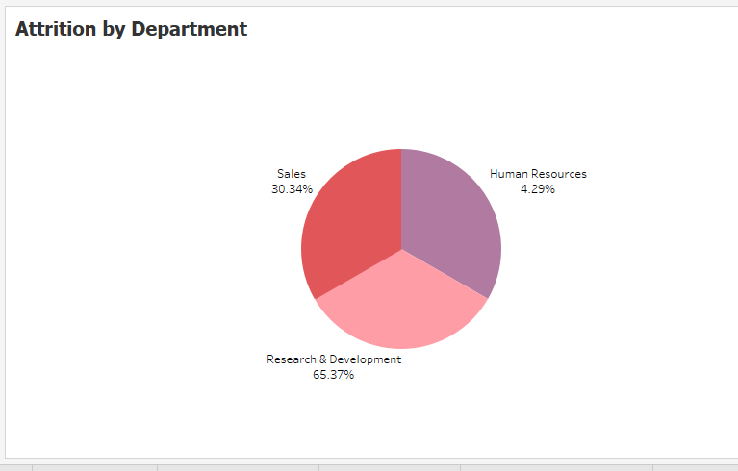
Attrition by Department

Slide 3
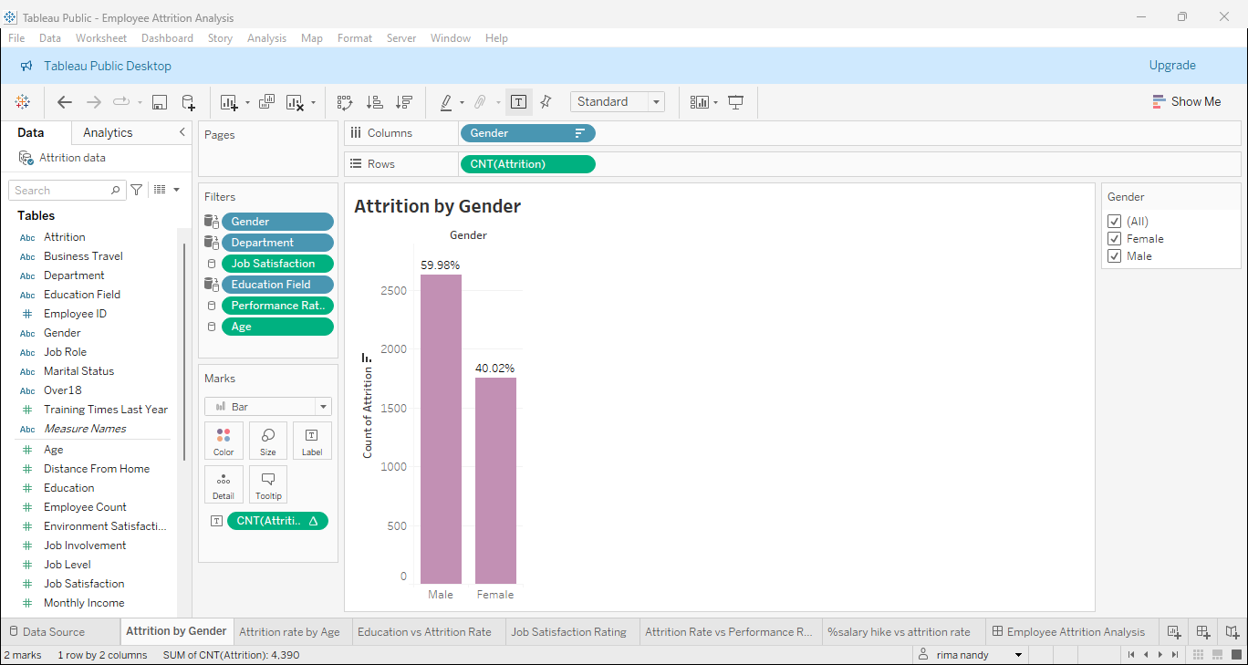
Attrition by Gender

Slide 4
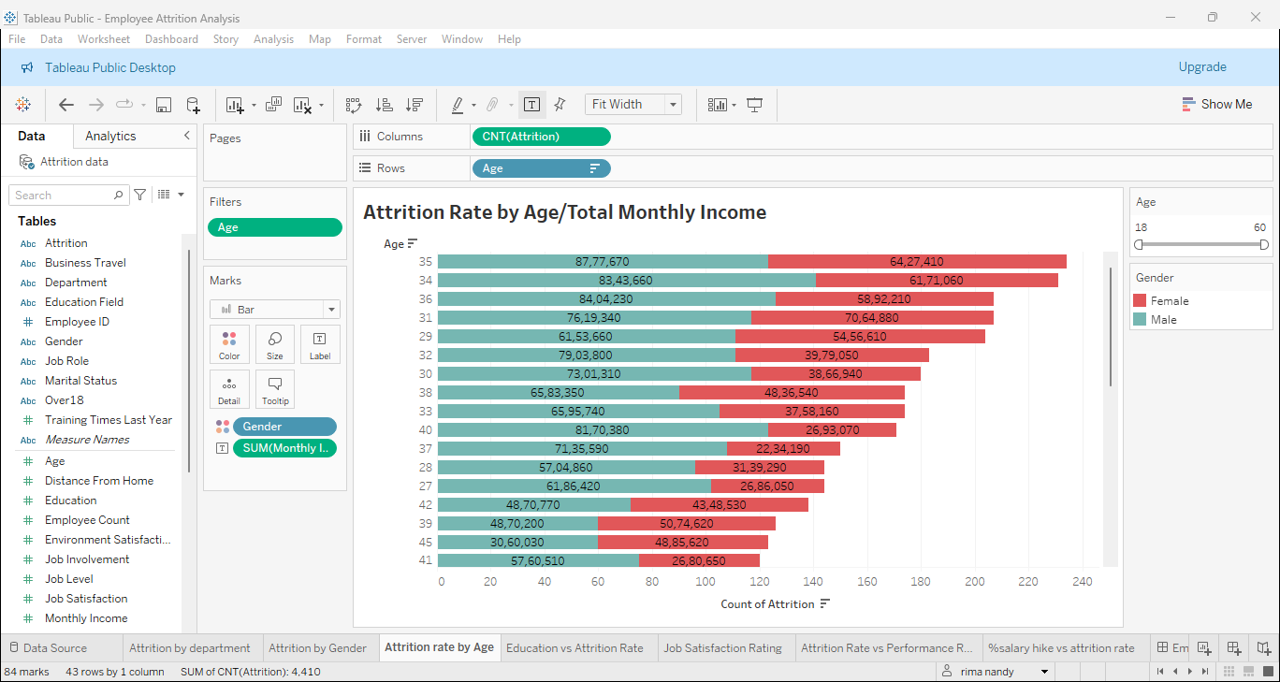
Attrition Rate by Age/Total Monthly Income

Slide 5
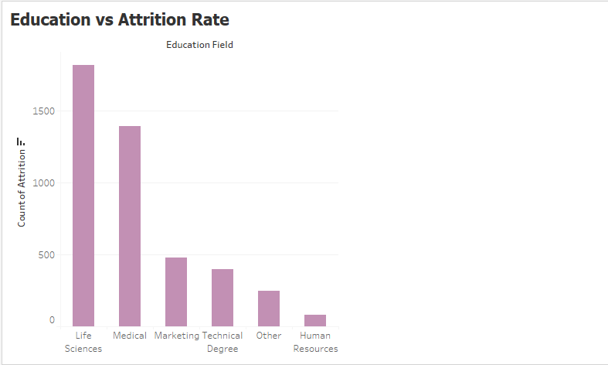
Education vs Attrition Rate

Slide 6
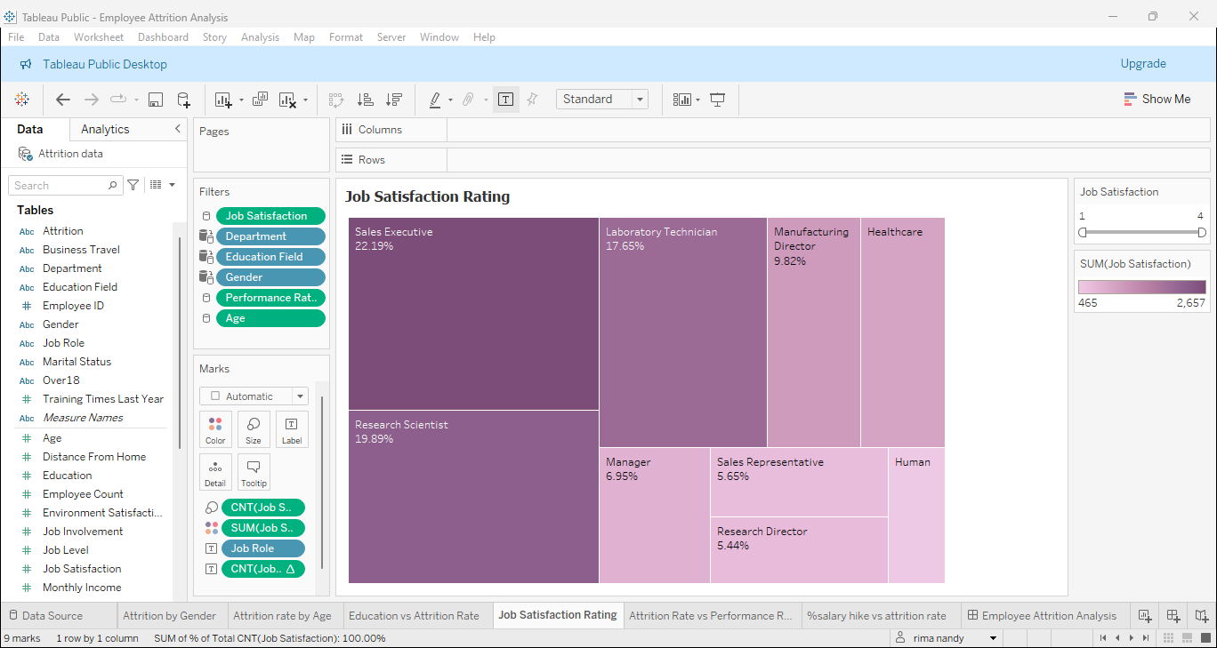
Job Satisfaction Rating

Slide 7
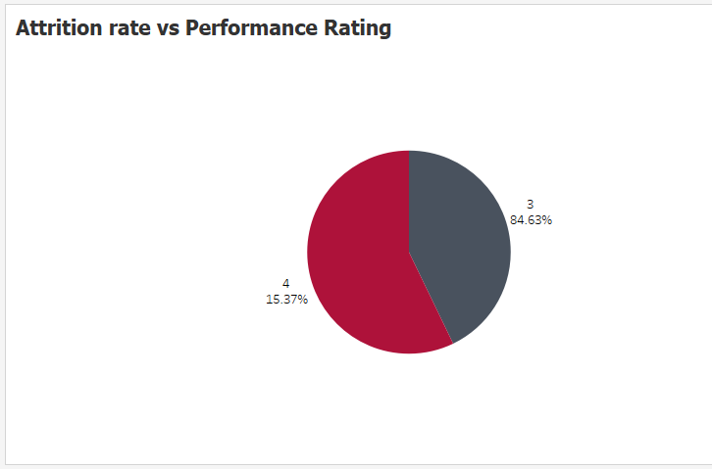
Attrition Rate vs Performance Rating

Slide 8
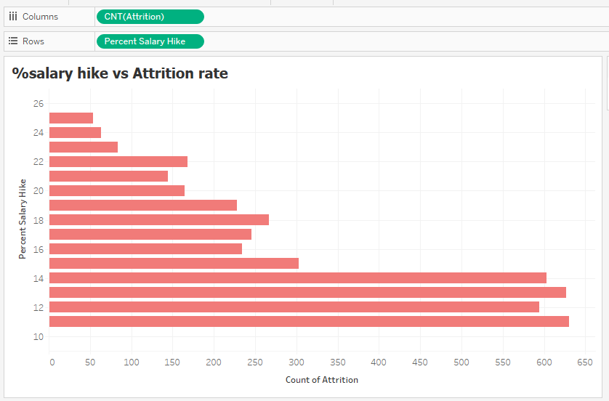
%Salary Hike vs Attrition Rate

Slide 9
Employee Attrition Analysis
From Employee Attrition Analysis, the following insights can be ascertained:
Department-wise Research & Development has the highest attrition rate of
65.37% followed by Sales at 30.34% and Human Resources at 4.29%
Male employees have a higher attrition rate than female employees.
Attrition rate is highest among male employees above the age of 35 years with an aggregate total income of Rs.87,77,670.
Employees having the educational background of Life Sciences, Medical and marketing have a higher attrition rate.
Employees pertaining to Human Resources, Sales Representatives and Research Directors have the lowest job satisfaction and hence the highest attrition rate.
Employees with the performance rating of 3 have the highest attrition rate- hence performance rating is positively linked to attrition rate.
Employees who have received a salary hike of just 10-12% have higher attrition rate than the employees who have received salary hike of 25% and more.

Slide 10
Thank You

